Slide 1
A mad Tea Party
Logic puzzles inspired by the world of Lewis Carroll

Slide 2
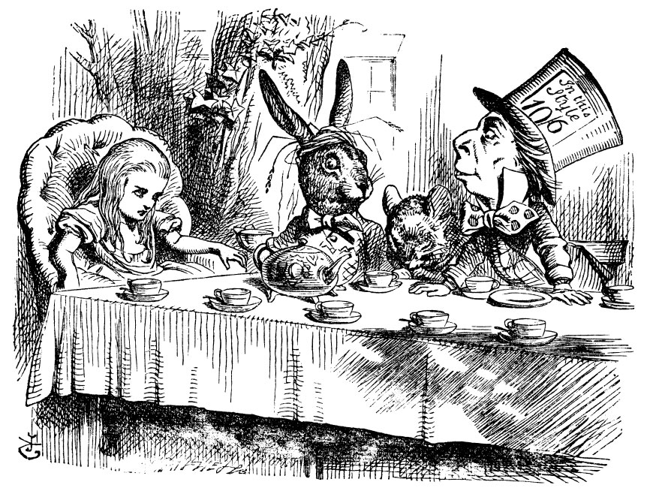


First things first
Tea
Cookies

Slide 3

Puzzle 1
You meet two dormice. One is named John.
One dormouse always tells the truth,
and one always lies.
You have only one chance to ask a single, 3-word question to one of the dormice.
Can you figure out whether John is a liar?

